Slide 1
Double Precision Architectural ED Tradeoff Analysis
Seng Oon Toh

Slide 2
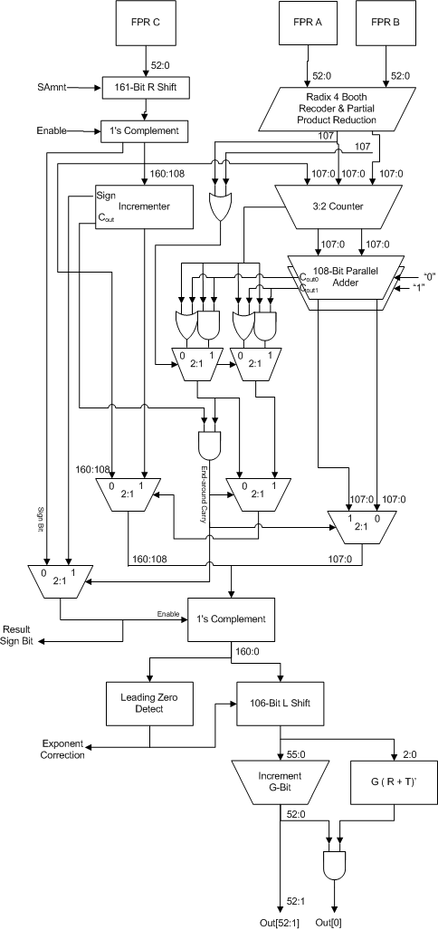

Slide 3
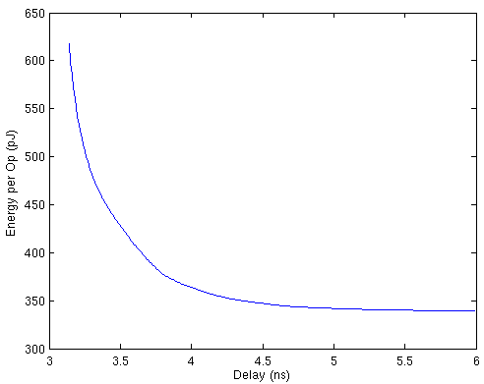
No Flops
Booth Encoder
4:2 Tree Stage 1
4:2 Tree Stage 2
4:2 Tree Stage 3
4:2 Tree Stage 4
3:2 Counter
108-Bit Parallel Adder
2:1 Mux
One’s Complement
Leading Zero Detect
Left Shift
Rounding Logic

Slide 4
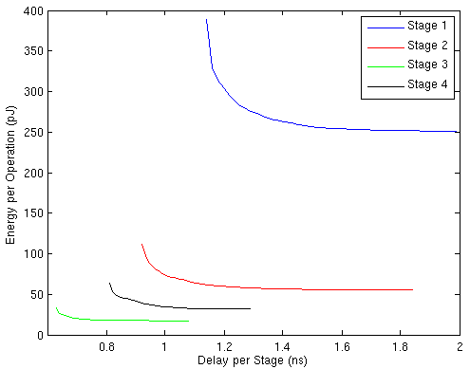
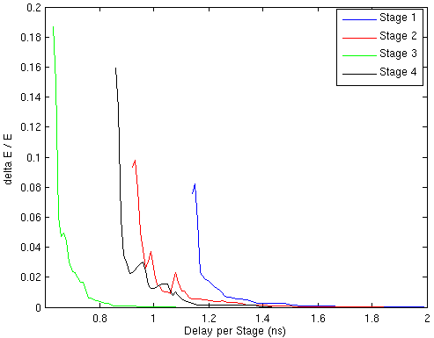
4 Stages
Booth Encoder
4:2 Tree Stage 1
4:2 Tree Stage 2
4:2 Tree Stage 3
4:2 Tree Stage 4
3:2 Counter
108-Bit Parallel Adder
2:1 Mux
One’s Complement
Leading Zero Detect
Left Shift
Rounding Logic
Energy (1.2 ns) = 413 pJ

Slide 5
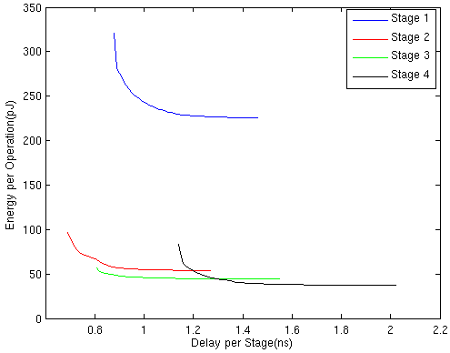
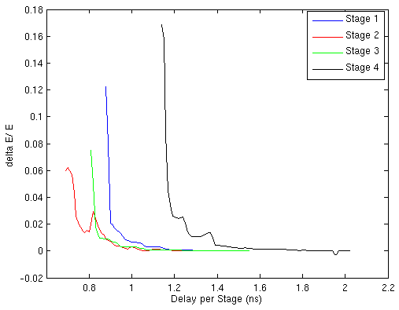
4 Stage - Retime
Booth Encoder
4:2 Tree Stage 1
4:2 Tree Stage 2
4:2 Tree Stage 3
4:2 Tree Stage 4
3:2 Counter
108-Bit Parallel Adder
2:1 Mux
One’s Complement
Leading Zero Detect
Left Shift
Rounding Logic
Energy (1.2 ns) = 380 pJ

Slide 6
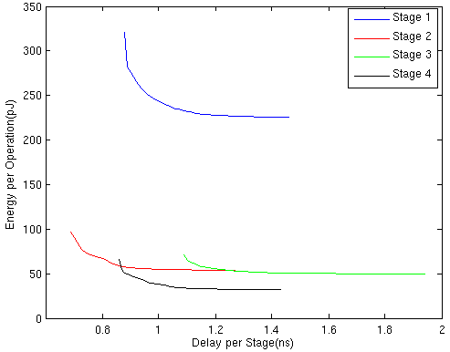
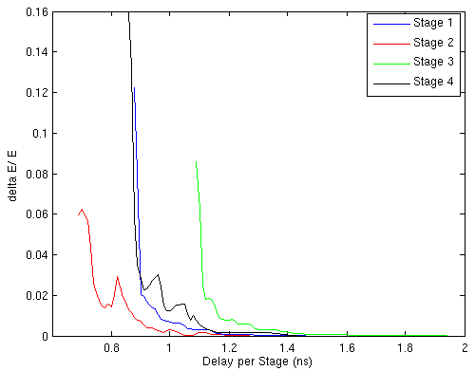
4 Stage - Retime
Booth Encoder
4:2 Tree Stage 1
4:2 Tree Stage 2
4:2 Tree Stage 3
4:2 Tree Stage 4
3:2 Counter
108-Bit Parallel Adder
2:1 Mux
One’s Complement
Leading Zero Detect
Left Shift
Rounding Logic
Energy (1.2 ns) = 370 pJ

Slide 7
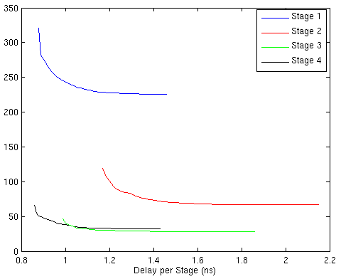
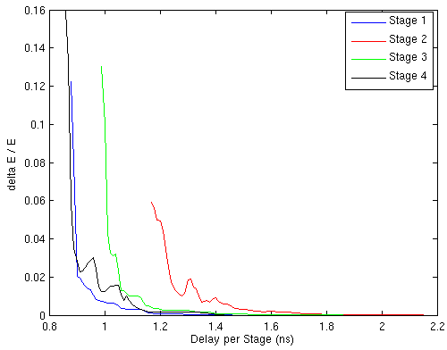
4 Stage – Unroll Parallel Adder
Booth Encoder
4:2 Tree Stage 1
4:2 Tree Stage 2
4:2 Tree Stage 3
4:2 Tree Stage 4
3:2 Counter
108-Bit Carry Tree
108-Bit End Around Adder
One’s Complement
Leading Zero Detect
Left Shift
Rounding Logic
Energy (1.2 ns) = 392 pJ

Slide 8
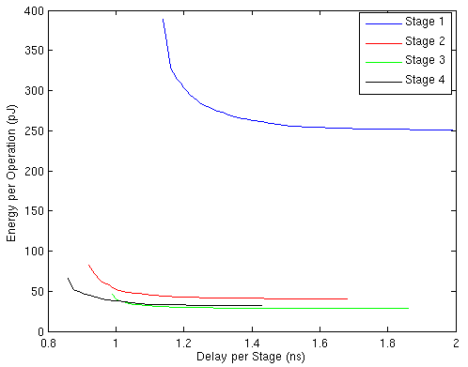
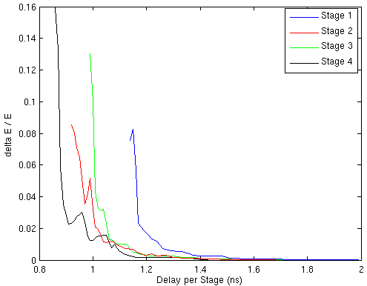
4 Stage – Retime
Booth Encoder
4:2 Tree Stage 1
4:2 Tree Stage 2
4:2 Tree Stage 3
4:2 Tree Stage 4
3:2 Counter
108-Bit Carry Tree
108-Bit End Around Adder
One’s Complement
Leading Zero Detect
Left Shift
Rounding Logic
Energy (1.2 ns) = 409 pJ

